Slide 1
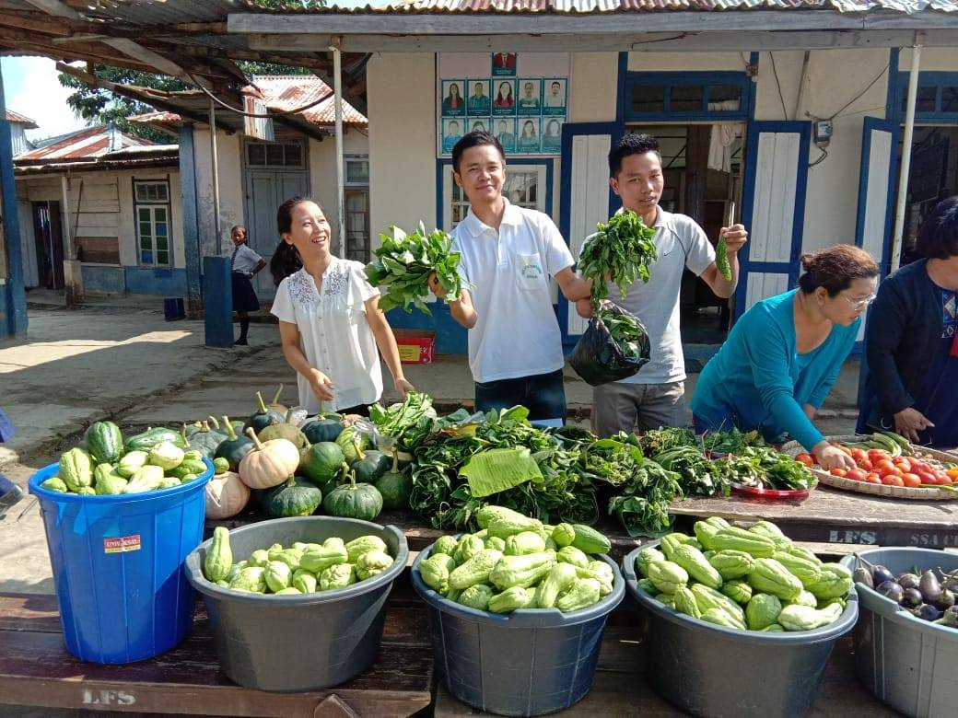
AWP&B 2019-20 MID-DAY MEAL SCHEME mizoram

Slide 2
performance during 2018 - 2019

Slide 3
SCHOOLS
PAB Approval 2018-19 |  |  | Existing School
PS | UPS | Total | PS | UPS | Total
1441 | 1091 | 2532 | 1431 | 1093 | 2524

Slide 4
STUDENTS COVERAGE
Average enrolment during 2018-19 |  |  | Enrolment Covered against PAB 2018-19
PS | UPS | Total | PS | UPS | Total
87152 | 39021 | 126174 | 95% | 94% | 95%

Slide 5
ENGAGEMENT OF COOK-CUM HELPER
PAB Approval 2018-19 |  |  | Actual engaged during 2019-20
PS | MS | Total | PS | MS | Total
3061 | 2159 | 5220 | 2822 (92%) | 2072 (96%) | 4894 (94%)

Slide 6
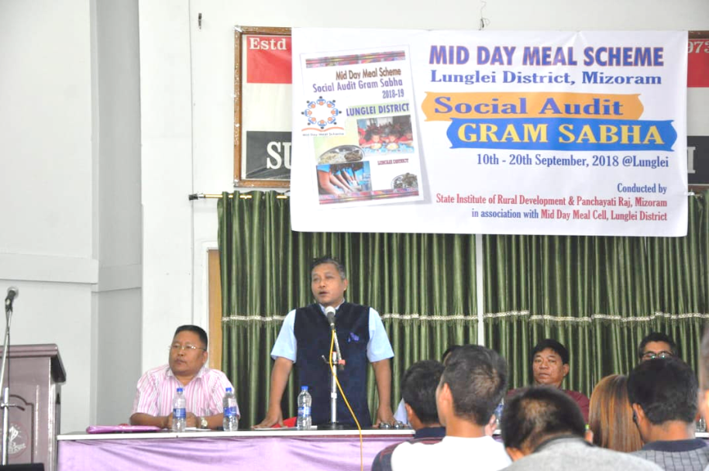
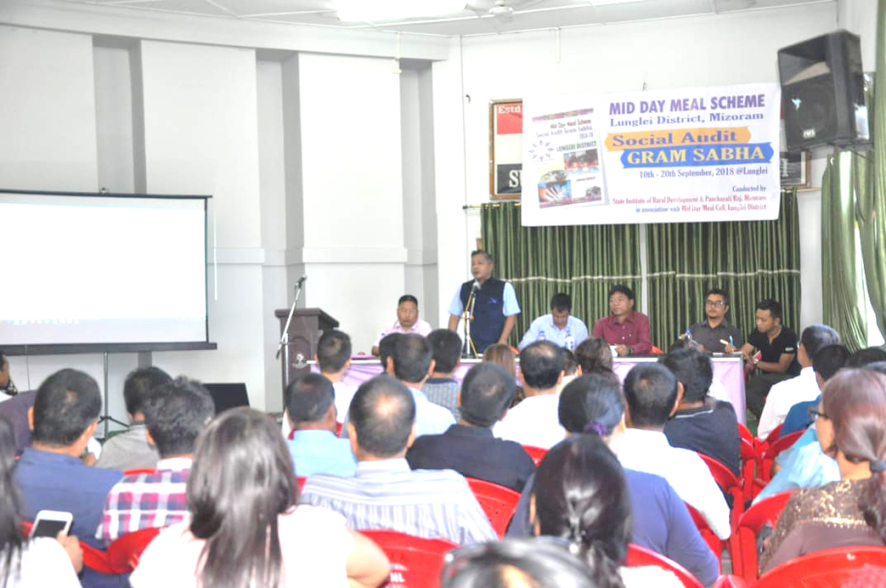
SOCIAL AUDIT
Social Audit was conducted in Lunglei District by engaging SIRD & PR. 20 Schools were covered. The reports of Social Audit has already been submited.

Slide 7
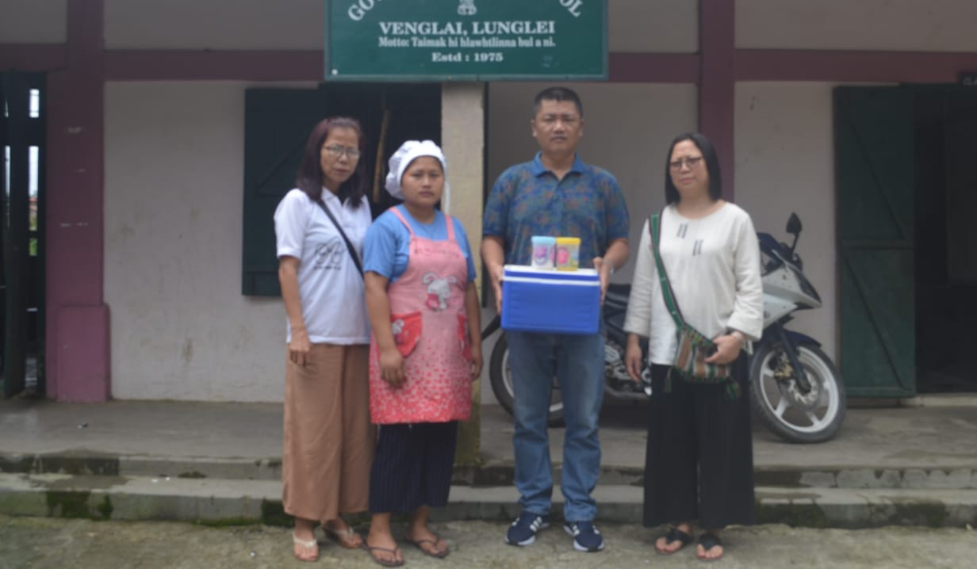
FOOD SAMPLE TESTING
All Districts have conducted Food Sample Testings during 2018-19 at RIPANS. Out of the 47 Samples tested only 27 samples are above the norms.
Though Districts are wiling to conduct more food sample testing, RIPANS could not test more sample due to heavy work load.

Slide 8
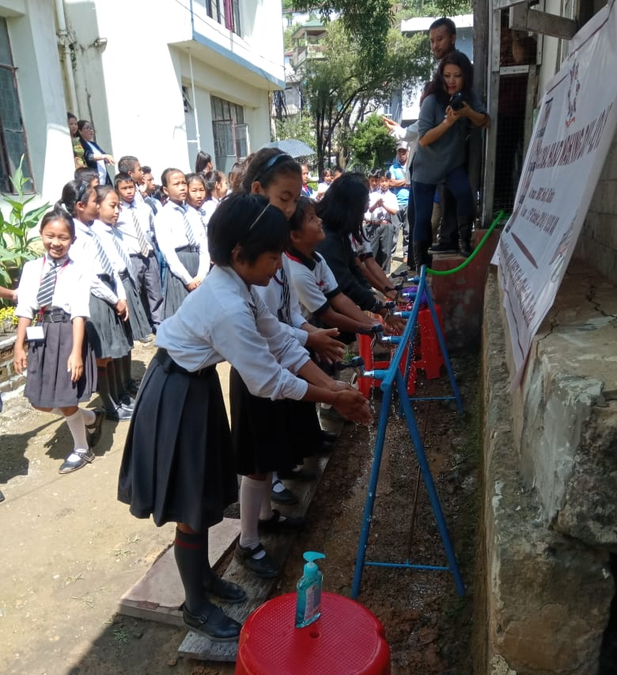
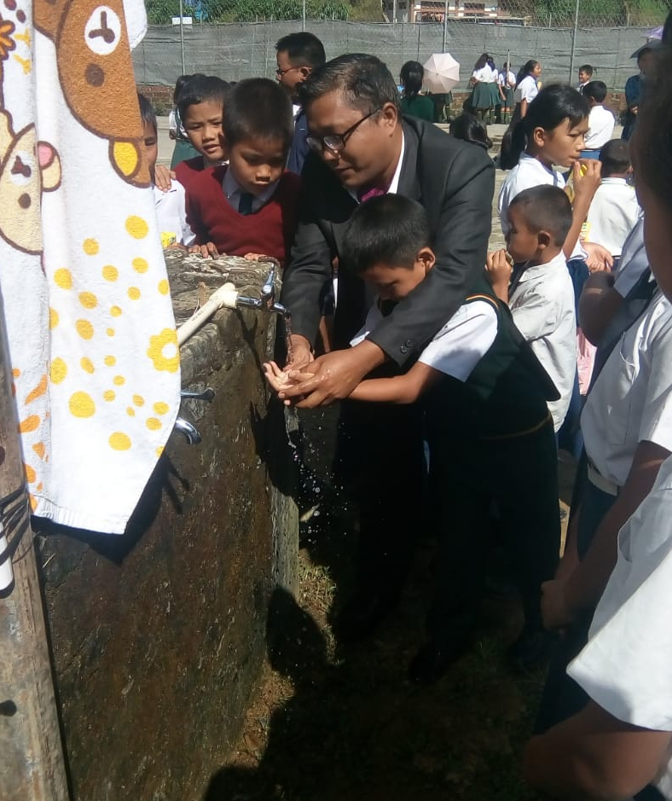
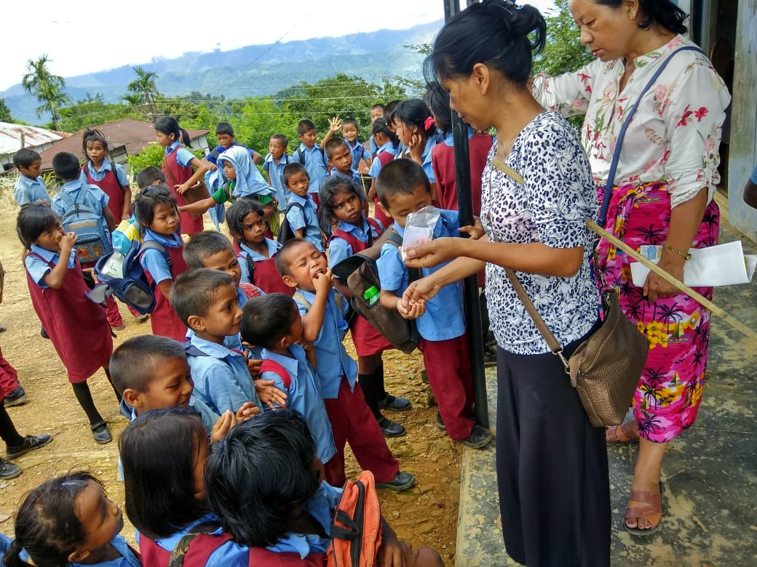
OBSERVANCE OF GLOBAL HAND WASHING DAY & NATIONAL DE-WORMING DAY
In coordination with H&FW Dept. and PHE Dept. Global Hand Washing Day was observed on 15th October, 2018 and National Deworming Day was also observed in all Schools in the State.

Slide 9
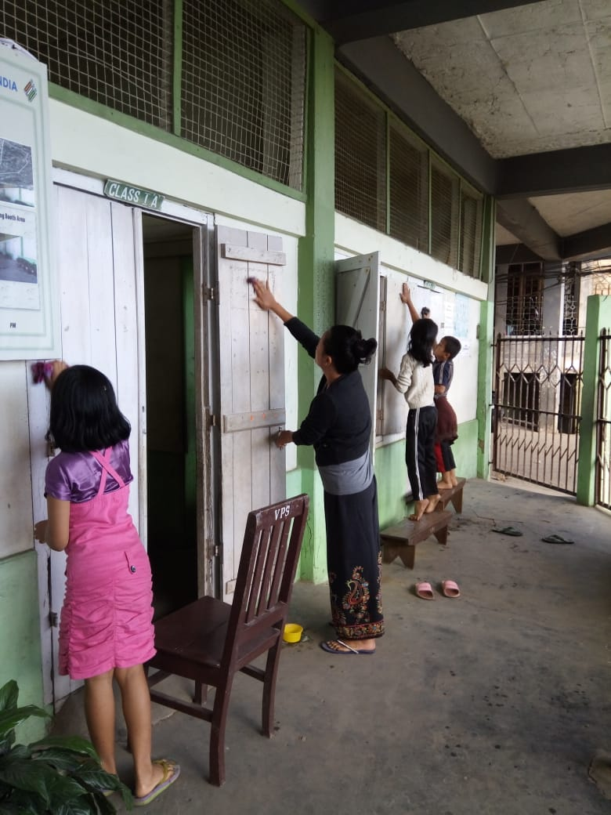
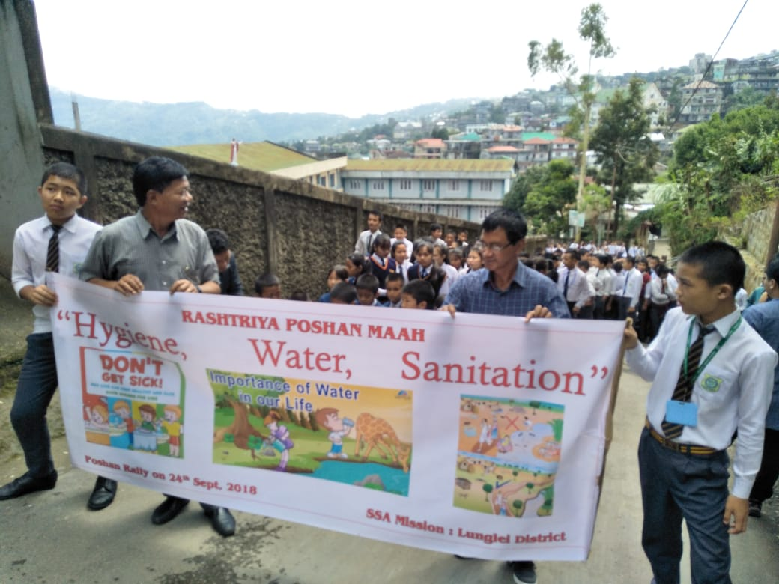
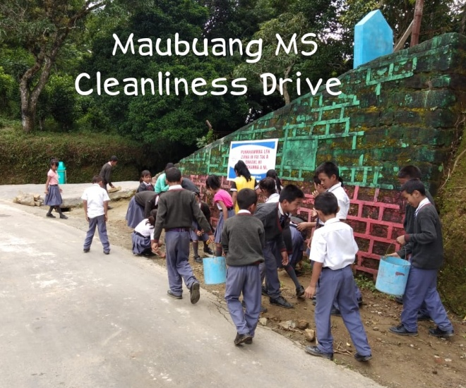
CELEBRATION OF RASHTRIYA POSHAN ABHIYAN
In collaboration with Social Welfare Department, Rashtriya Poshan Maah was observed in the State. Certain activities were performed during 2018.

Slide 10
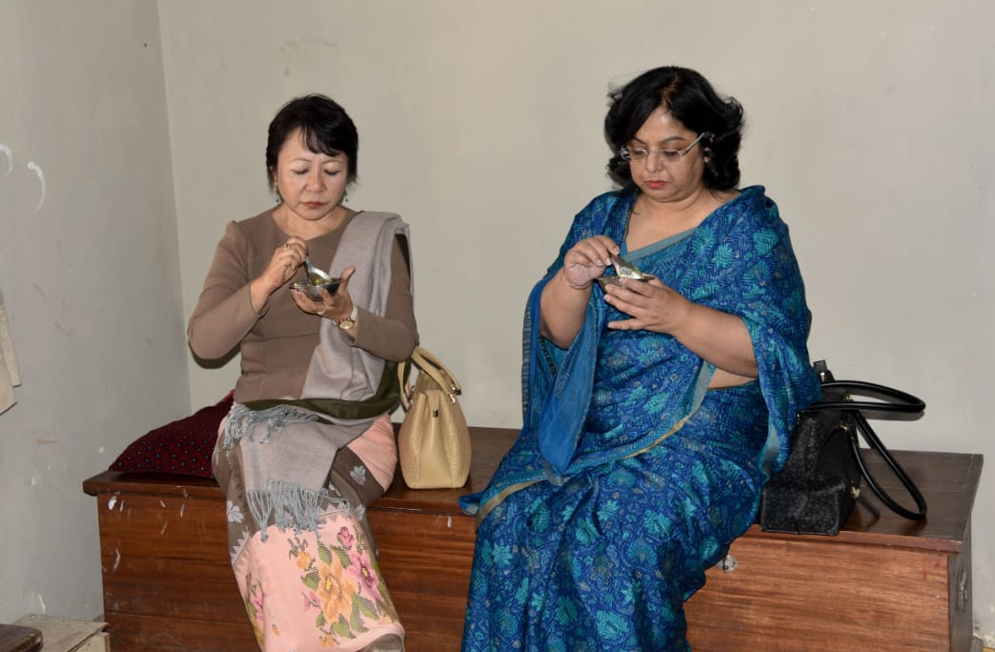
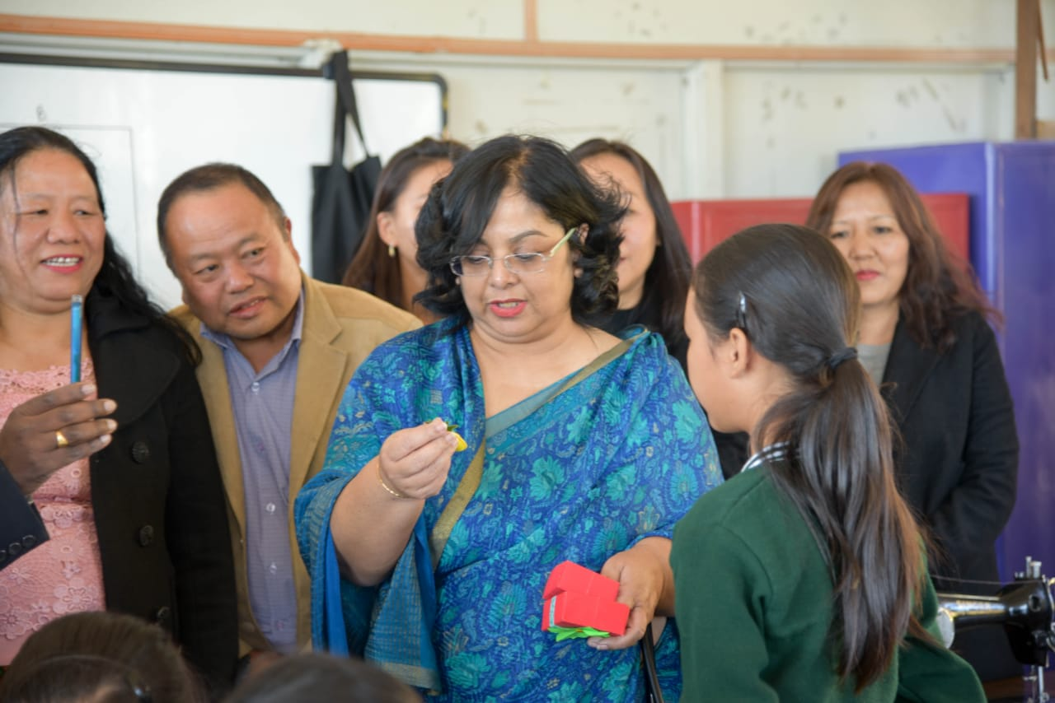
INSPECTION & MONITORING
Inspection & Monitoring of Mid-Day Meal is actively done in the State. During 2018-19 the State had a special guest Mrs. Rina Ray, Secretary, MHRD, SE&L, Govt of India who visited our schools and tasted Mid-Day Meal and interacted with school Children. School Education Department, Govt. of Mizoram really appreciated her visit.

Slide 11
COVERAGE UNDER RBSK (SCHOOL HEALTH) - 2018-19
Medical team under RBSK Programme visited our schools children to check their health status. From the findings of these visits, children requiring medical care are refered to Hospital and those requiring spectacles were also provided. During 2018-19, 130 spectacles were distributed to school childrens. Under school Health programme WIFS and deworming tablets are given to children regularly.

Slide 12
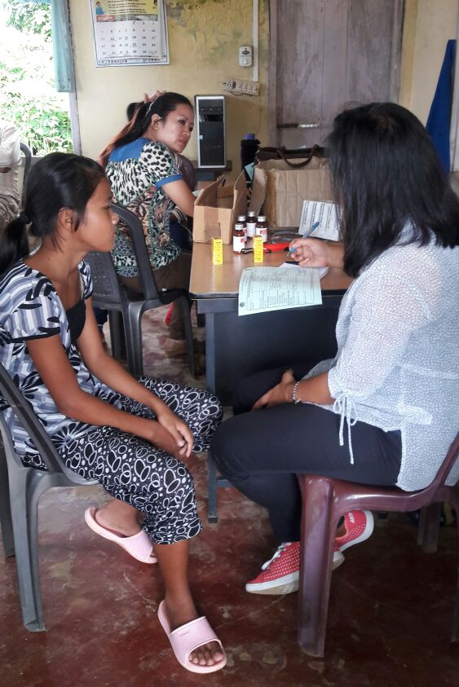
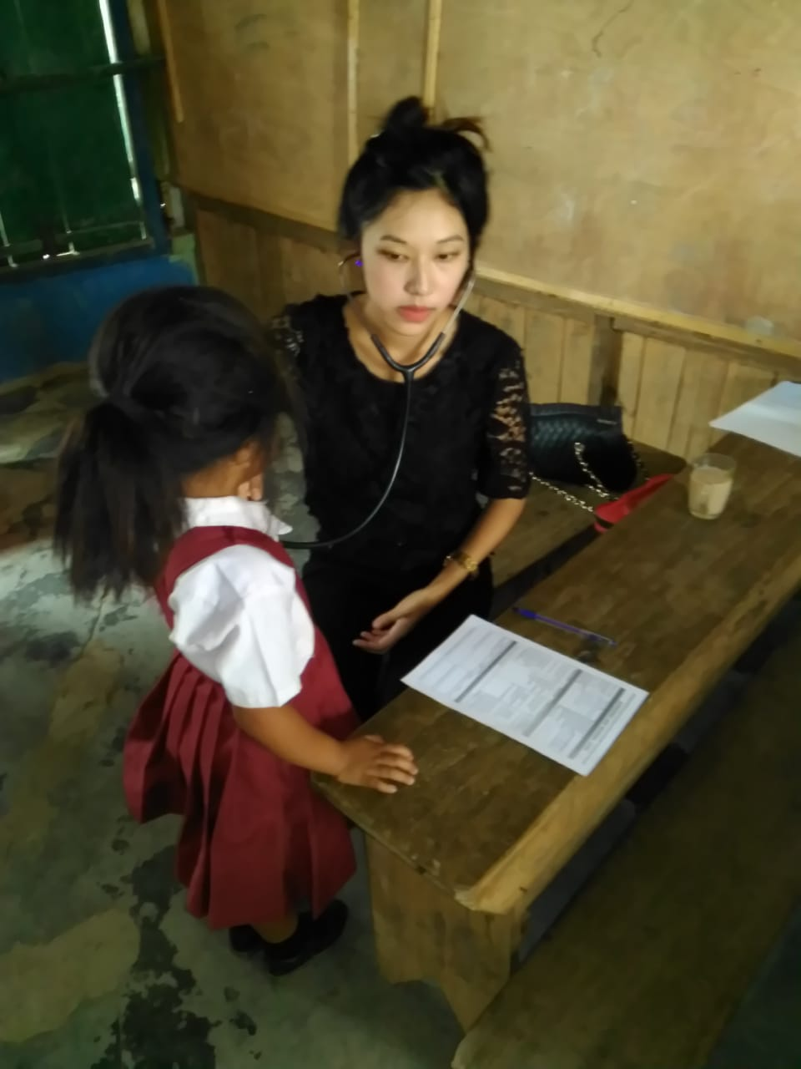
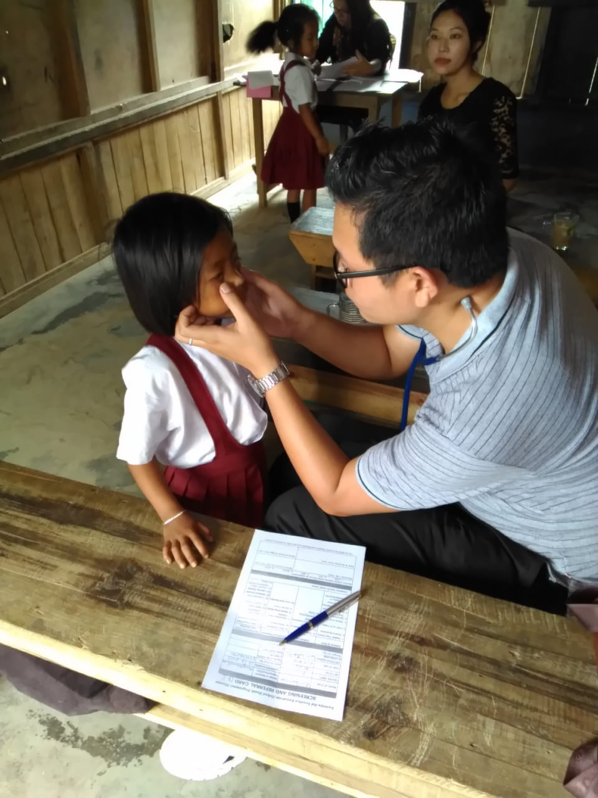
COVERAGE UNDER RBSK- HEALTH CHECK UP

Slide 13
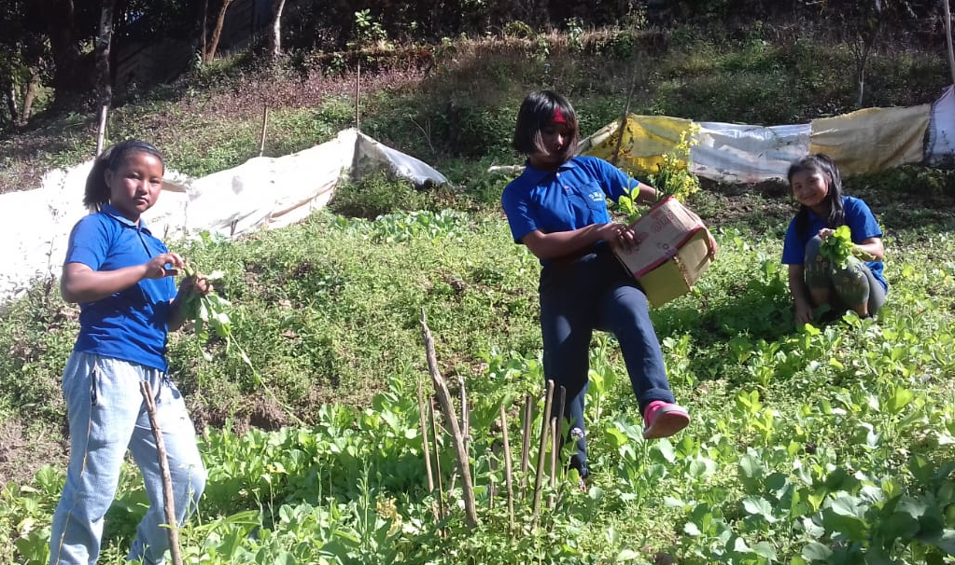
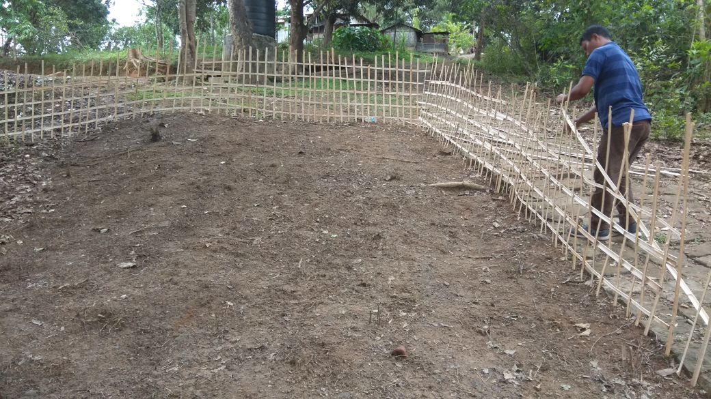
NUTRITIONAL KITCHEN GARDENS IN THE STATE
227 schools having available land for setting up of Kitchen Gardens have been started with community participation. With the 50% of the new flexi fund of 5% over and above the AWP&B 2019-20, the state of Mizoram will upgrade these 227 Kitchen Gardens and set up another new 1093 Nutritional Gardens.

Slide 14
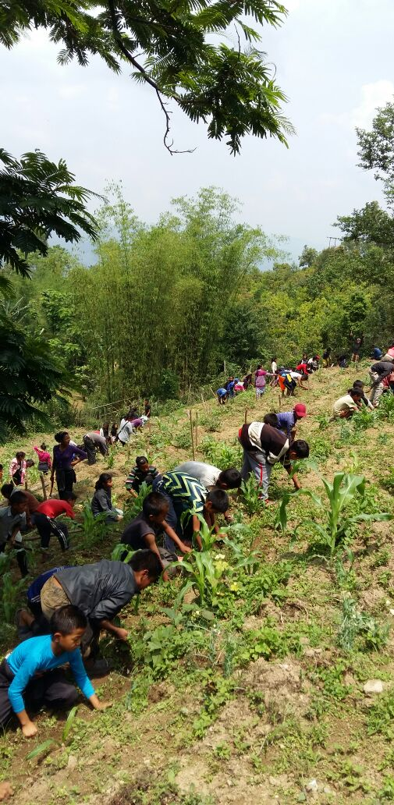
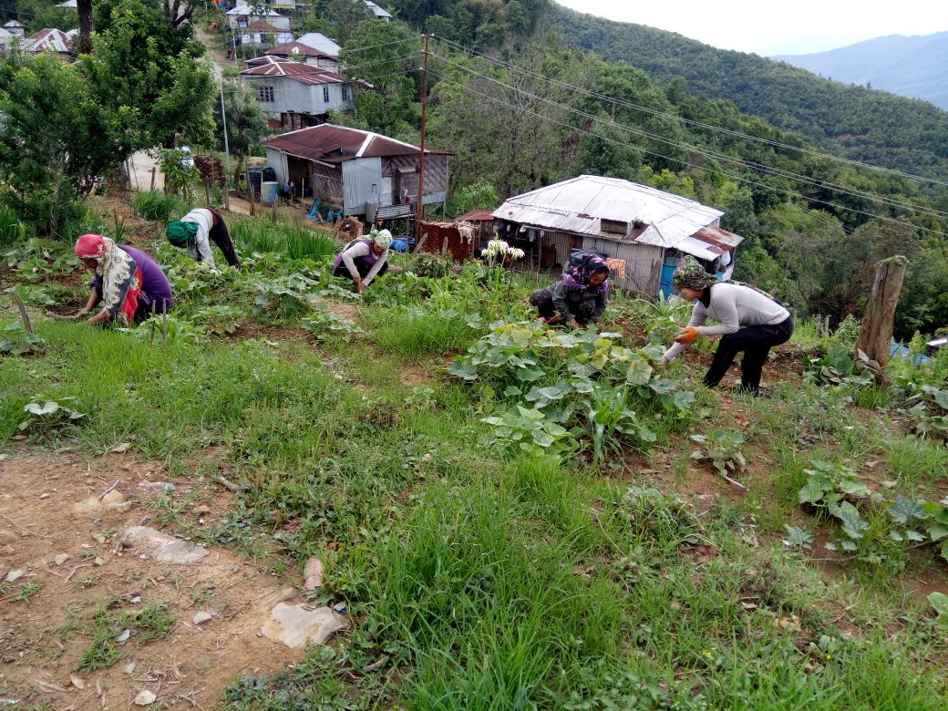
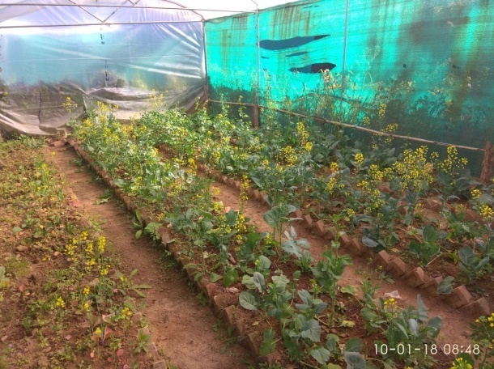
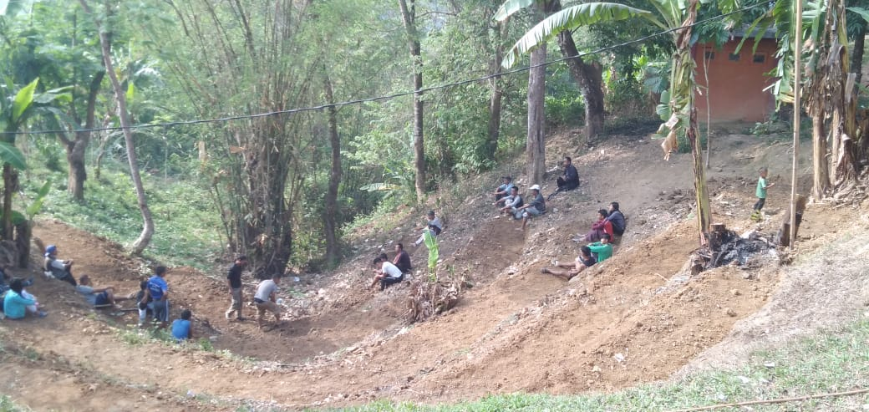
KITCHEN GARDENS IN THE STATE

Slide 15
BEST PRACTICES
The State Government is contributing cooking cost of Re. 1.00, which is more than the minimum mandatory share of Re. 0.65 in Upper Primary School (Cl-VI-VIII) whereas in Primary Schools the state is contributing Rs. 1.2 which is more than the minimum mandatory share of Re. 0.44.
As for Honorarium to Cook-cum-Helper, the State Government is contributing Rs. 600/- or (40%) which is Rs. 500/- more than the minimum mandatory share of Rs. 100/-
The State Government provided fund for Construction of 10 Kitchen shed under NEDP @ Rs. 3.15 lakh per Unit during 2018-19. Construction of these ten Kitchen Sheds are nearly completed.

Slide 16
COMMUNITY PARTICIPATION
The Community is actively involved for the succesful implementation of Mid-Day Meal. They take keen interest in collection of firewood, rendering their services for construction of Kitchen Shed and Kitchen Gardens. They also enthusiastically contributed their Garden products like fruits and vegetables for their childrens’ Mid-Day Meal

Slide 17
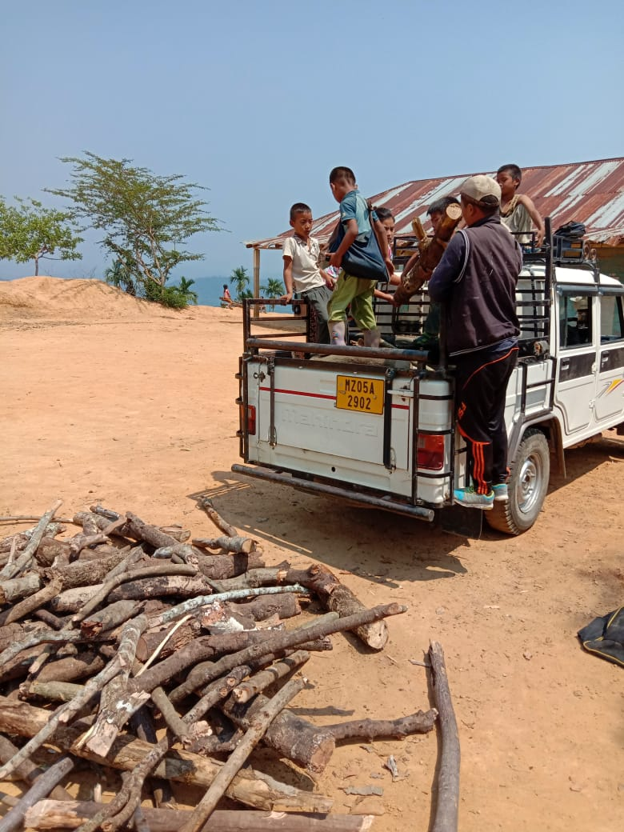
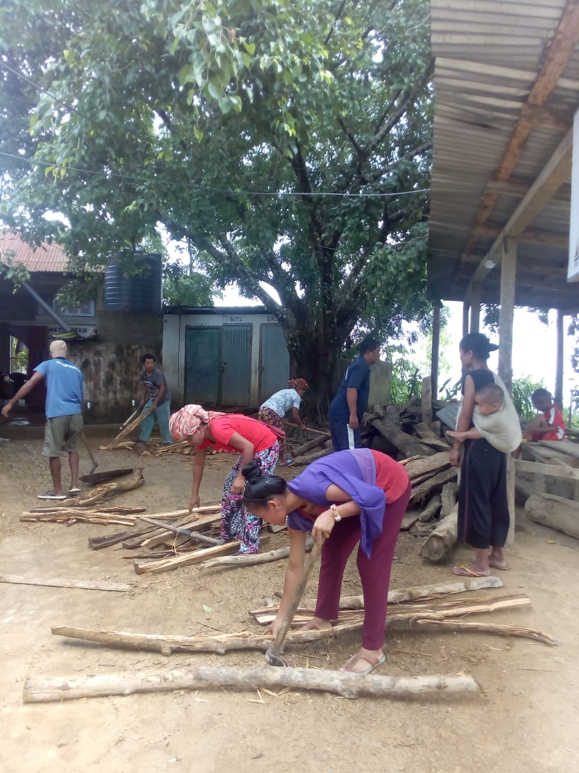
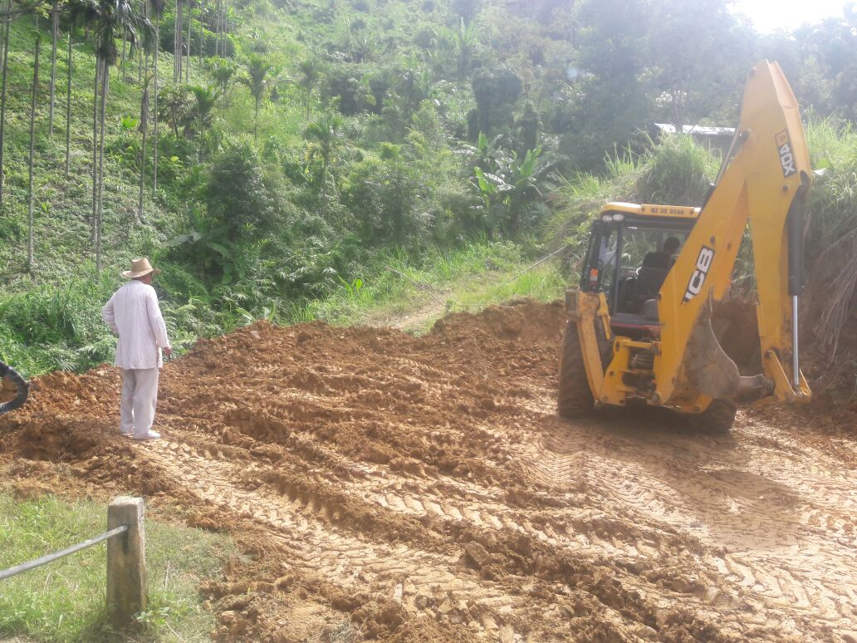
COMMUNITY PARTICIPATION

Slide 18
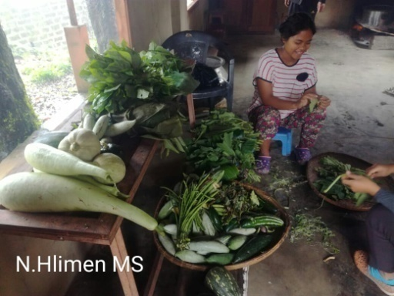
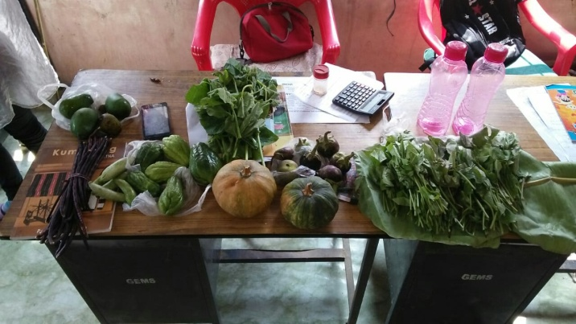
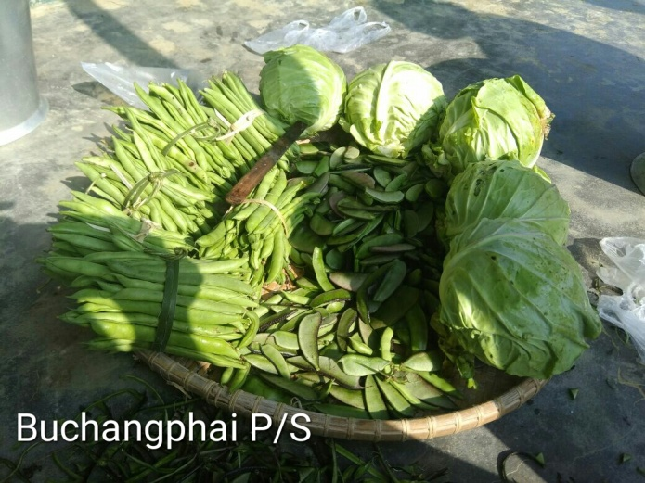
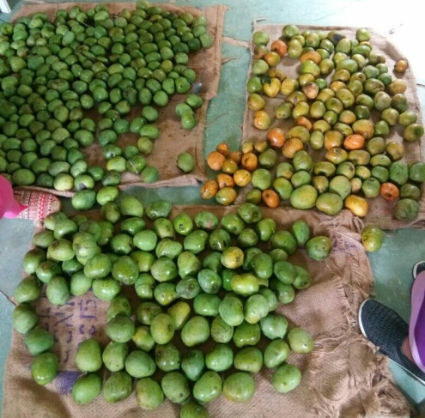
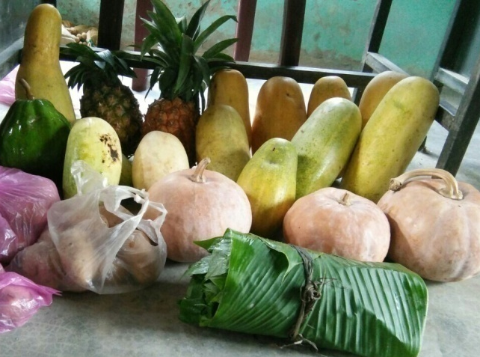
COMMUNITY PARTICIPATION
Community Contribution

Slide 19
ISSUES

Slide 20
ISSUES
Delay in release of fund.
Low Hononarium of Cook-cum-Helpers.
Cyclonic destruction of two Kitchen Sheds in Siaha District require re-construction immediately.

Slide 21
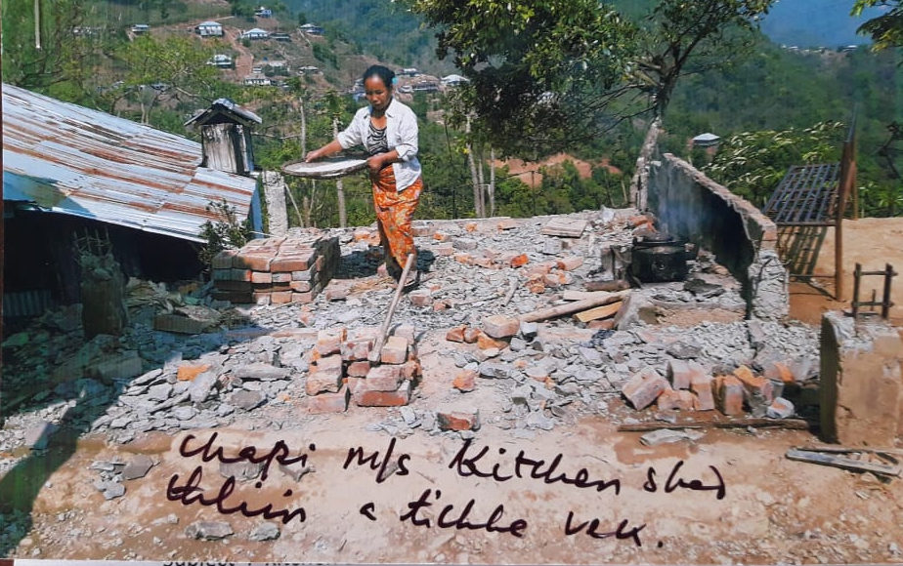
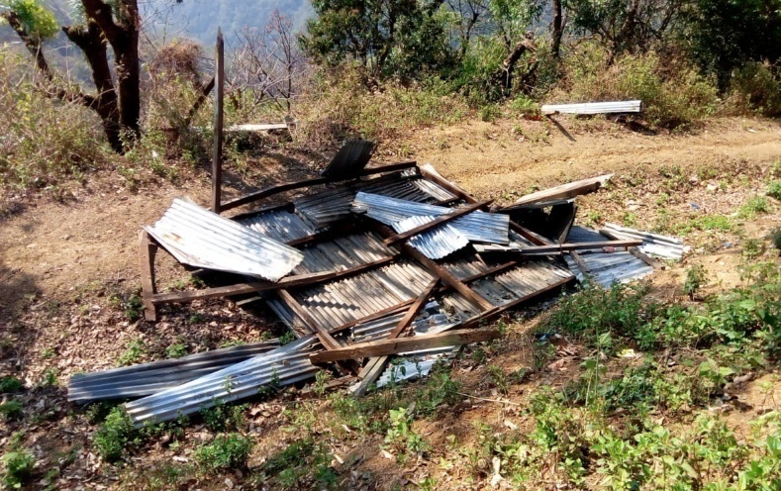
ISSUES
Picture of two cyclonic destructed Kitchen Sheds of Siaha District

Slide 22
TARGETS

Slide 23
TARGETS FOR IMPROVEMENT DURING 2019-2020
100% Coverage of Aadhaar Enrolment of Children.
Training of Cook-cum-Helpers.
Selection of Good Kitchen Garden at District and State level.
Conduct of Cooking competition.
Dedication of two days in a year as “Lawmna Ruai Ni” in line with the spirit of Tithi Bhojan.

Slide 24
PROPOSAL FOR 2019-20

Slide 25
PROPOSAL FOR 2019-20 Physical
Sl. No | Component | PS | UPS | TOTAL
1 | Schools | 1431 | 1093 | 2524
2 | Enrollment | 87,152 | 39,021 | 126173
3 | Working Days (Primary) | 202 | 212 | -
4 | Cook-Cum-Helper | 2,822 | 2,072 | 4,894
5 | Kitchen-cum-Store | - | 7 | 7
6 | Kitchen Devices (New) | - | 7 | 7
7 | Repair of kitchen-cum-stores | 766 | 767 | 1,533

Slide 26
Thank you

